Slide 1

Research Plan
“How do different media institutions define and avoid fake news within the cross-cultural contexts of China and England?”

Slide 2
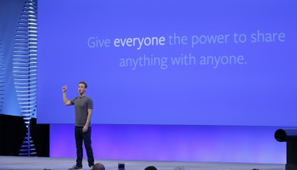
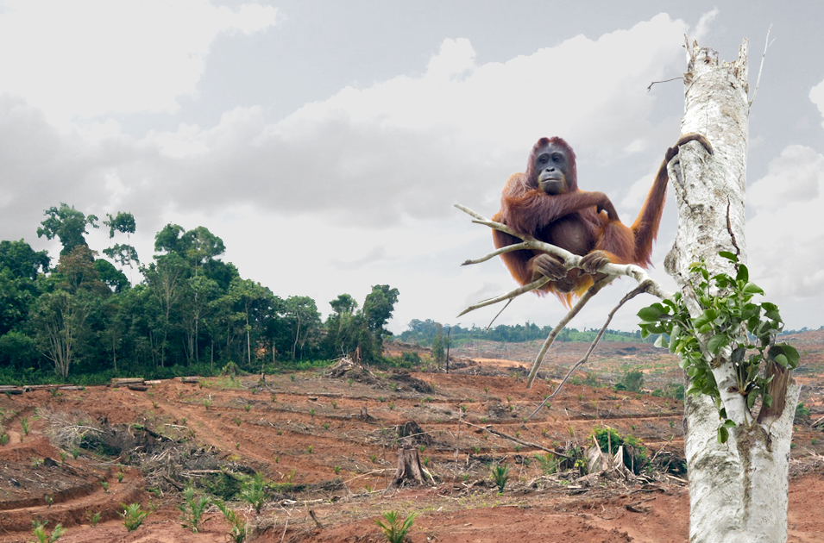
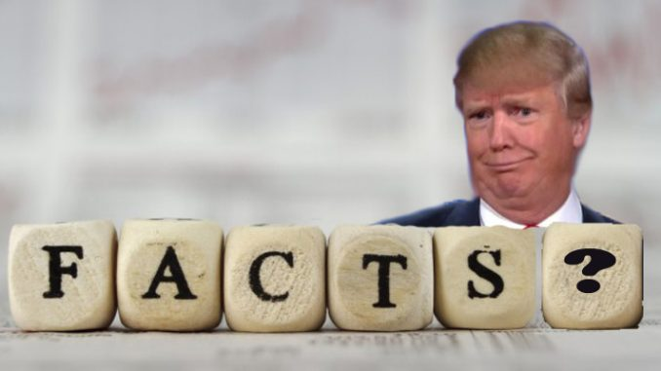
Our Portfolio
Fake news consistently appeared arbitrary and difficult to define, appearing in a myriad of forms on a variety of different platforms
Many accounts of fake news don’t take into consideration the differences exemplified on a global platform

Slide 3
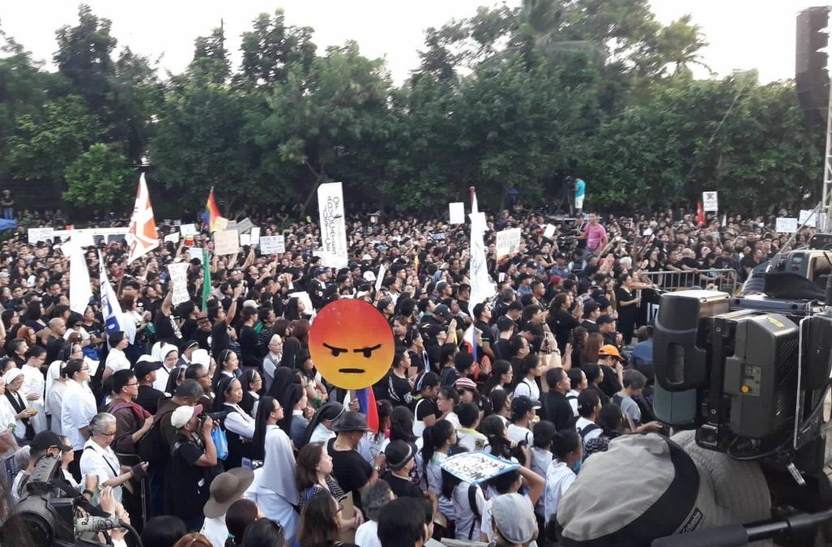
Research Questions
“How do different media institutions define and avoid fake news within the cross-cultural contexts of China and England?”
How can you define fake news where there is an obesity of news?
What are the differences between nations where there is open government censorship and where there is not?
Does fake news include what is not said through censorship or power relations over knowledge?
Do certain practices give rise to more fake news?

Slide 4
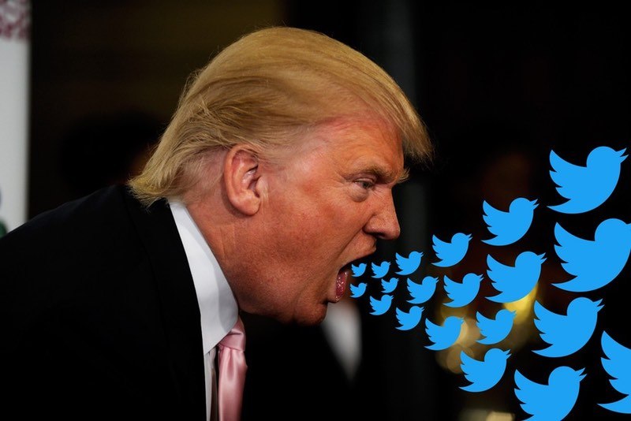
Rationale
Why are we asking these questions?
To build on current arbitrary understandings
To avoid making assumptions of what fake news is to different people across the globe
To take a step back and consider the effects on democracy
To understand contemporary fake news as grounded in a long history of contested media production (such as propaganda)
To explore the impact of government censorship (following MP’s discussions to combat it)
To explore the popular use of the phrase ‘post-truth’

Slide 5
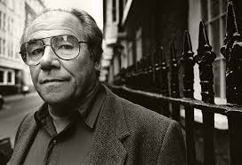
Hyper-reality
…a world in which a lack of real information, is concealed by an over production of simulacra
(signs that do not seek to represent the real) (1981)
Baudrillard refers to this implosion of information as an ‘ecstasy’ of communication, through which less real communication actually occurs (1988).
The obesity of information may reduce the level of reflexivity and consequently allows Fake News stories to circulate more freely online.

Slide 6
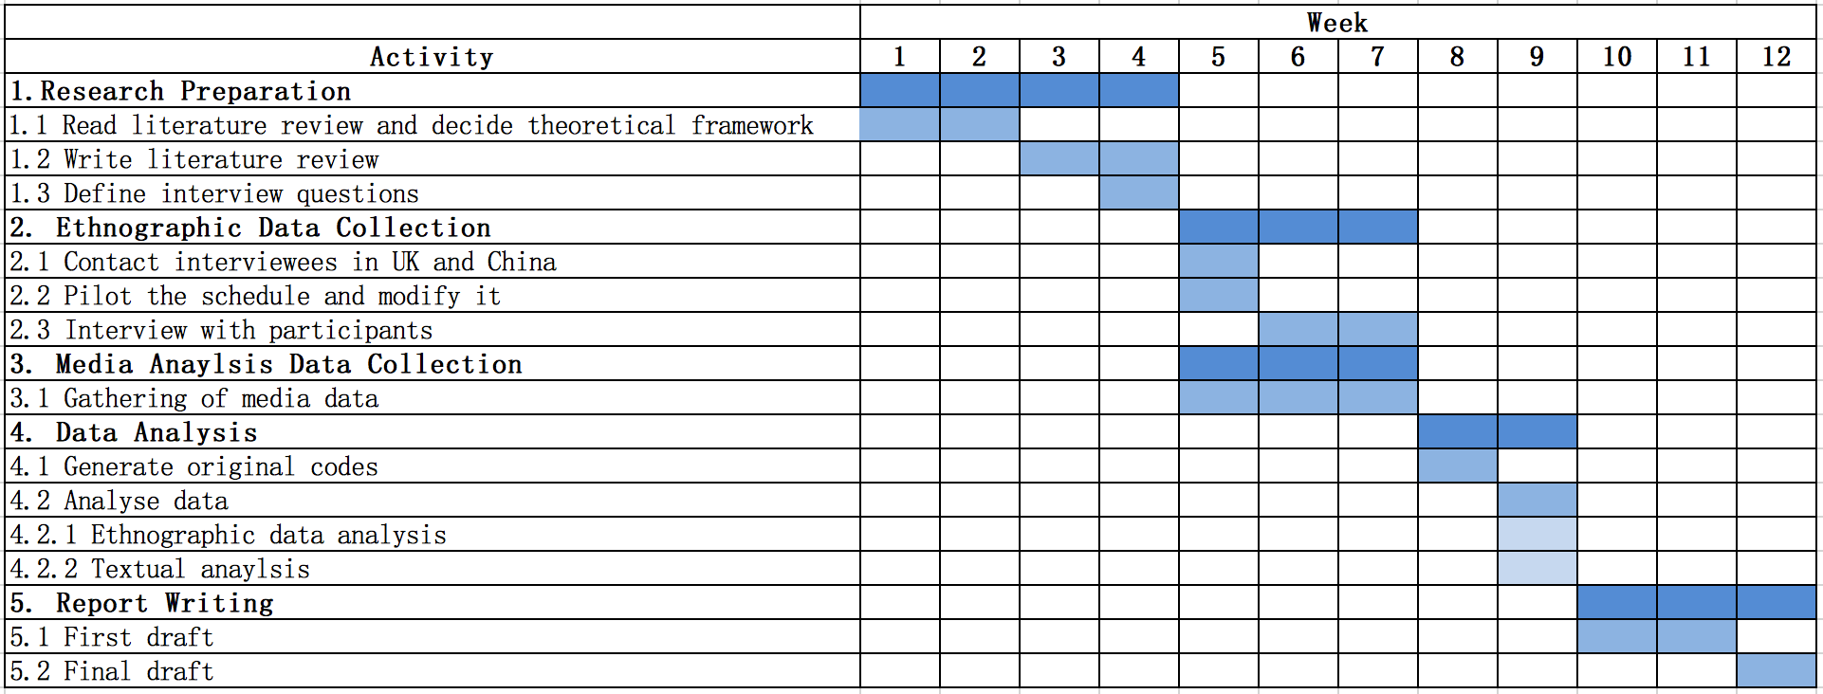
Research Timetable

Slide 7
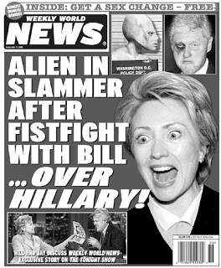
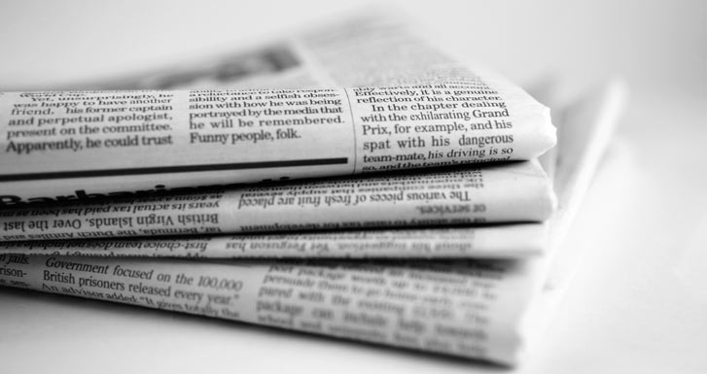
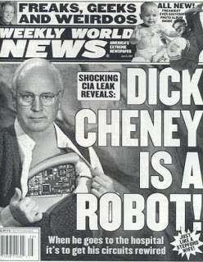
Ethnography
"Ethnography is the recording and analysis of a culture or society, usually based on participant-observation and resulting in a written account of a people, place or institution”
(Coleman and Simpson).

Slide 8
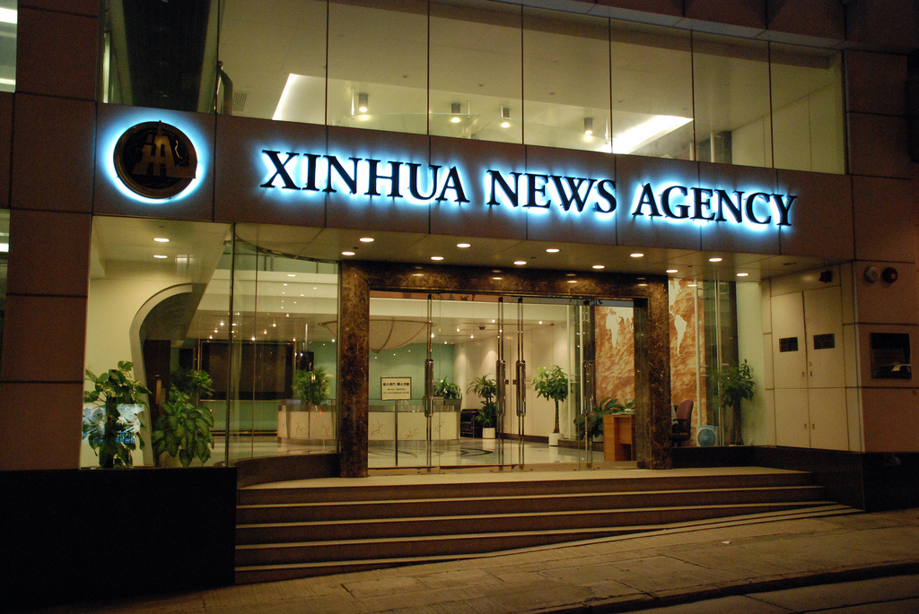
Ethnography
Xinhua is the biggest and most influential media organization in China.
The place where we can observe directly how the government-backed institution defines and avoids fake news
Participant Observation
Insight into the everyday practices
Journalists/ producers will feel comfortable with researcher presence over time
Allows a sufficient rapport to be built up before…
Interviews
Qualitative data
May uncover why news is produced in certain ways in addition to how
Xinhua News Agency

Slide 9
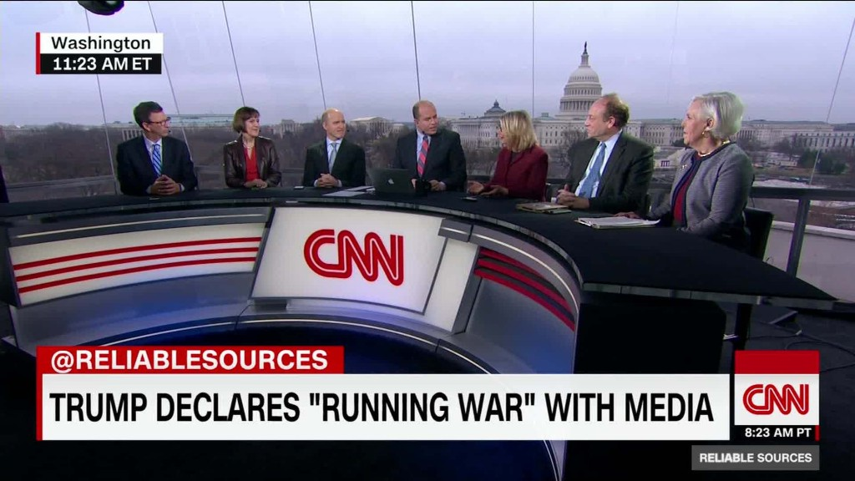
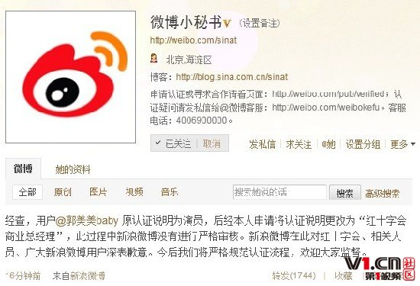

Textual Analysis
“How does a text get taken up in particular social and cultural contexts?” (Couldry)
signifier & signified
relations between these signs
textual environment
intertextuality
‘the dense network of interconnections between texts’

Slide 10

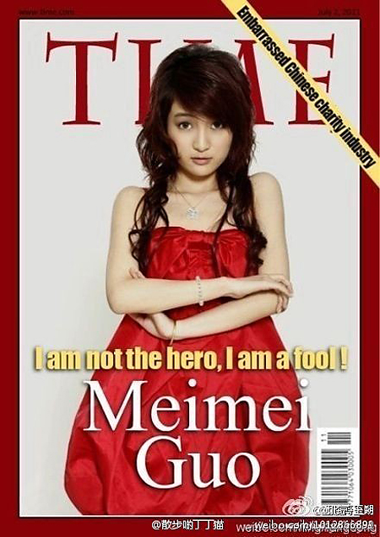
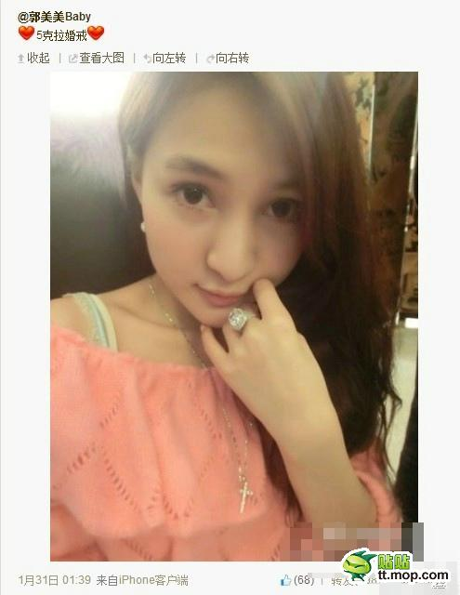
Fake News Examples
contrasting producers
contrasting cultures
The Sun as a ‘reputable’ source for many readers?
Issues surrounding gender and representation

Slide 11
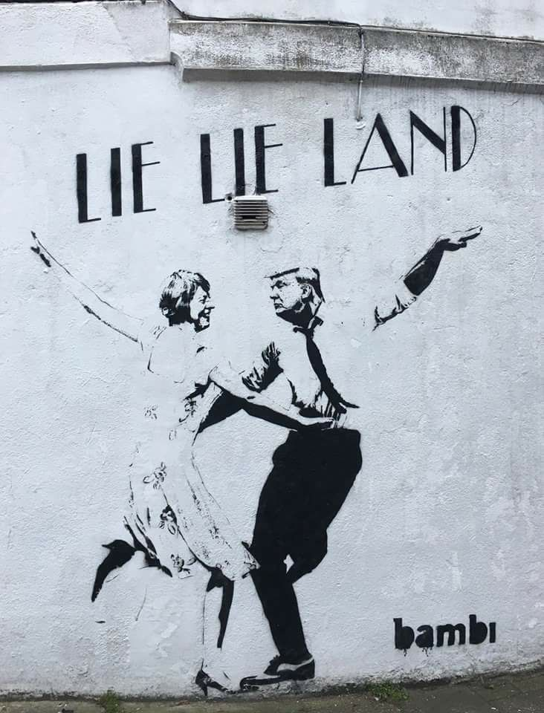
Conclusion & Implication
Strengths
Fake news is not a new phenomenon in China and so there is a rich literature landscape already available
Breaks down Eurocentric sociological understandings
Limitations
We may face repercussions from the Chinese government for discussing censored content
Power imbalances between journalists and ethnographers

Slide 12
References
Back, L. (2007) The Art of Listening, London: Berg.
Baudrillard, J. (1983). Simulations. Translated by: Foss, P. Patton, P. & Beitchman, P. New York: Semiotexte Inc.
Baudrillard, J. (1983). ‘The Implosion of Meaning in the Media’, In the Shadow of the Silent Majorities, New York: Semiotexte, pp.95-110.
Beech, H., n.d. TIME’s Pretty Young Cover Girl Who Wasn’t. Time.
Bet Qin, David S., Yanhui Wu (2017) Why Does China Allow Freer Social Media? Protests versus Surveillance and Propaganda, Journal of Economic Perspectives, 31(1):117-140
Couldry, Nick. (2000) Inside Culture: Re-Imagining the Method of Cultural Studies, Sage.
Chinadaily.com.cn (2015)Profile: Guo Meimel URL:http://www.chinadaily.com.cn/china/2015-09/10/content_21839962.htm
CNN, S.L. and K.H., n.d. Chinese social media celebrity Guo Meimei sentenced [WWW Document]. CNN. URL http://www.cnn.com/2015/09/11/asia/china-guo-meimei-charge/index.html (accessed 3.22.17).
Gao, H., n.d. Rumor, Lies, and Weibo: How Social Media is Changing the Nature of Truth in China.
Guan, W., Gao, H., Yang, M., Li, Y., Ma, H., Qian, W., Cao, Z., Yang, X., 2014. Analyzing user behavior of the micro-blogging website Sina Weibo during hot social events. Physica A: Statistical Mechanics and its Applications 395, 340–351. doi:10.1016/j.physa.2013.09.059
Guo Meimei scandal shows Chinese Red Cross must clean up its act [WWW Document], 2014. . South China Morning Post. URL http://www.scmp.com/comment/insight-opinion/article/1570876/guo-meimei-scandal-shows-chinese-red-cross-must-clean-its (accessed 3.22.17).
Hine, C. (2000) Virtual Ethnography London, Thousand Oaks and New Delhi: Sage.
How China’s highly censored WeChat and Weibo fight fake news [WWW Document], 2016. . South China Morning Post. URL http://www.scmp.com/news/china/policies-politics/article/2055179/what-facebook-can-learn-chinas-wechat-and-weibo-how (accessed 3.22.17).
Keats, D. (1999) Interviewing: A Practical Guide for Students and Professionals, Sydney: UNSW Press.
Xia, F., Zhang, Q., Wang, C., Qian, W., Zhou, A., 2015. On the rise and fall of Sina Weibo: Analysis based on a fixed user group. IEEE, pp. 224–231. doi:10.1109/ICDEW.2015.7129580
Yu, L.L., Asur, S., Huberman, B.A., 2015. Trend Dynamics and Attention in Chinese Social Media. American Behavioral Scientist 59, 1142–1156. doi:10.1177/0002764215580619
Zhang, L., Amos, C., Pentina, I., 2015. Information Disclosure on a Chinese Social Media Platform. Journal of Information Privacy and Security 11, 3–18. doi:10.1080/15536548.2015.1010981

